Slide 1
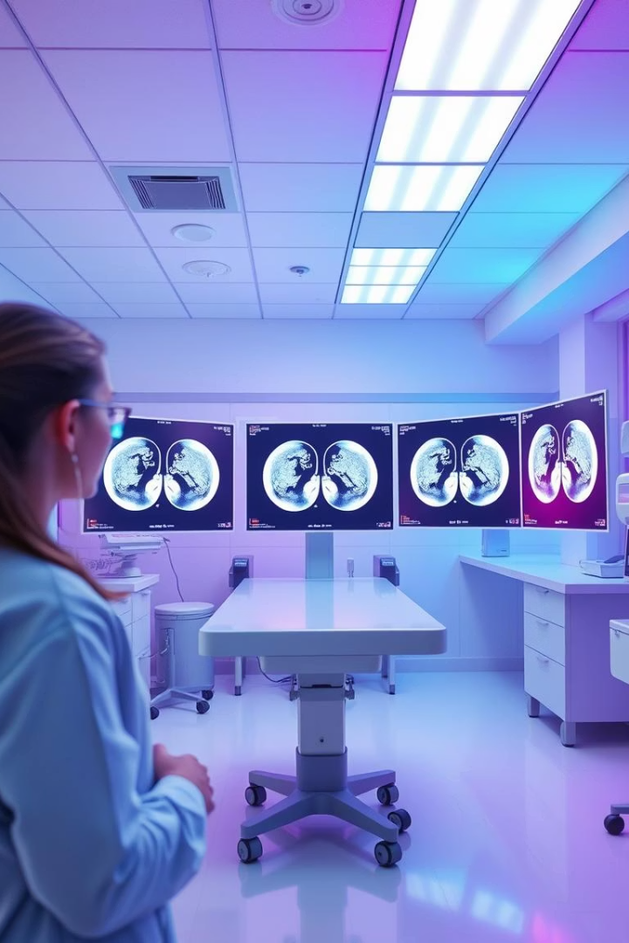
Vision-Based Cancer Detection
AI-powered early cancer detection using CT scans offers hope for higher survival rates.
By- Nitika Bhatia

Slide 2

What Are We Solving?
Problem
Impact
Need
Late-stage cancer detection reduces survival significantly.
Survival rates drop from 80% to 20% if detected late.
More accurate early detection methods are critical.

Slide 3
How Can AI Help?
Deep Learning
CT Scans
AI Solution
CNNs excel at analyzing medical images with high precision.
Provide detailed 3D images of internal organs for analysis.
Automates scan review, highlighting suspicious areas for doctors.

Slide 4
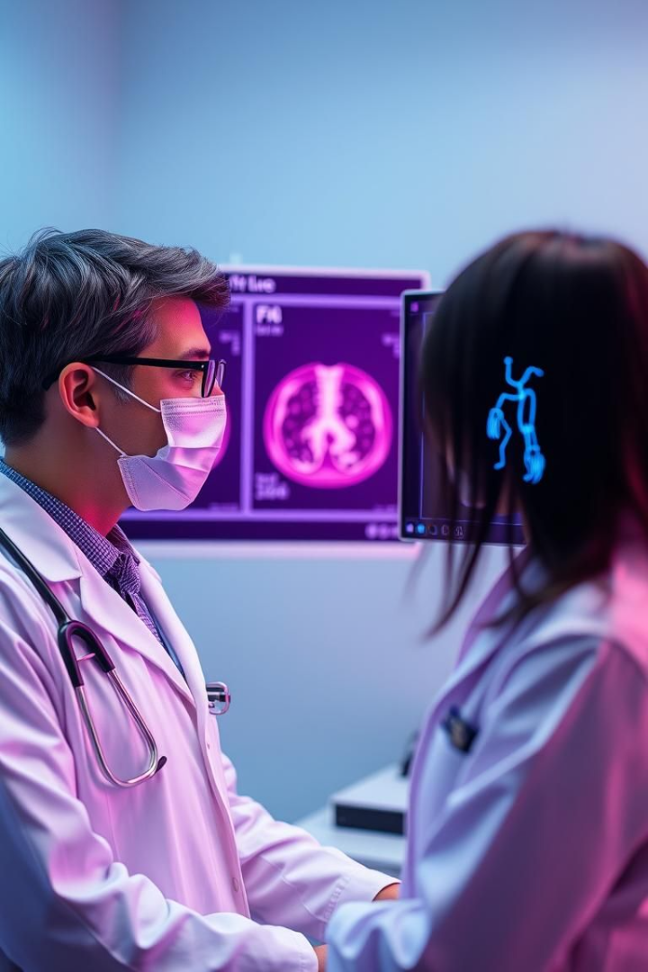
Project Overview
1
Goal
2
Method
Detect cancerous nodules early using AI models.
Train CNNs on labeled CT images to identify nodules.
3
Outcome
Support radiologists with faster, accurate cancer detection.

Slide 5
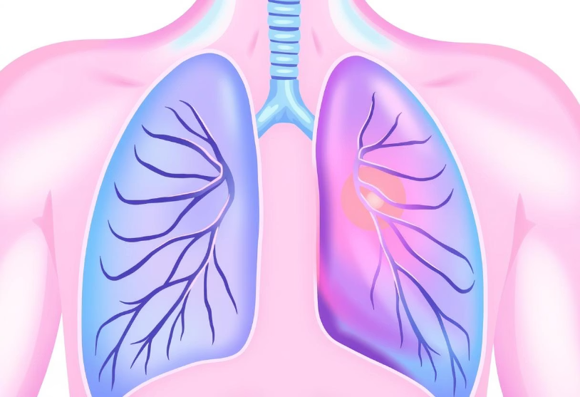
Understanding the Dataset
LUNA16 Dataset
Examples
Lung Nodule Analysis 2016 dataset used for training.
CT images with and without nodules highlighted.
888 chest CT scans
DICOM format images
Annotated nodules for supervised learning

Slide 6
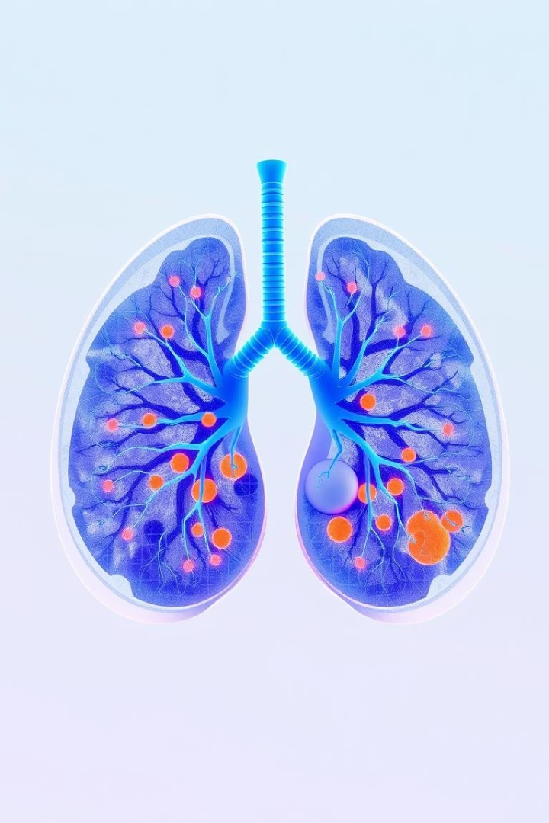




Methodology
Preprocessing
Normalize scans and segment lungs for focused analysis.
CNN Architecture
Utilize 3D CNNs to detect and classify nodules.
Training
Apply data augmentation and cross-validation techniques.
Evaluation
Measure sensitivity, specificity, F1-score, and AUC.

Slide 7



Results and Evaluation
Reliable Specificity
2
85% specificity improves false positive reduction.
High Sensitivity
1
Achieved 92% sensitivity on validation data.
Model Improvement
15% F1-score increase compared to baseline.
3

Slide 8

Conclusion and Future Work
Summary
AI demonstrates strong potential for early cancer detection.
Next Steps
Enhance model accuracy and clinical workflow integration.
Future Research
Expand to other cancers and imaging types.

